Slide 1

Wild weather

Slide 2
Review
What is the thickness and composition of the atmosphere?
How is the atmosphere affected by the lithosphere and hydrosphere?
What is the greenhouse effect and which gases are responsible for it?
Name (and for bonus points write formulae) for five compounds that contain nitrogen within the nitrogen cycle.

Slide 3


Slide 4
Learning Intentions
considering the role of science in identifying and explaining the causes of climate change
considering how computer modelling has improved knowledge and predictability of phenomena such as climate change and atmospheric pollution
describing how science is used in the media to explain a natural event or justify people’s actions
considering the scientific knowledge used in discussions relating to climate change

Slide 5
Success criteria
Use data to analyse historical patterns of cyclones
List and describe global features associated with frequent cyclones, eg latitudes, continental or oceanic features
List features of cyclones that create damage to life or property
Name 3 countries or continents that get a lot of cyclones

Slide 6

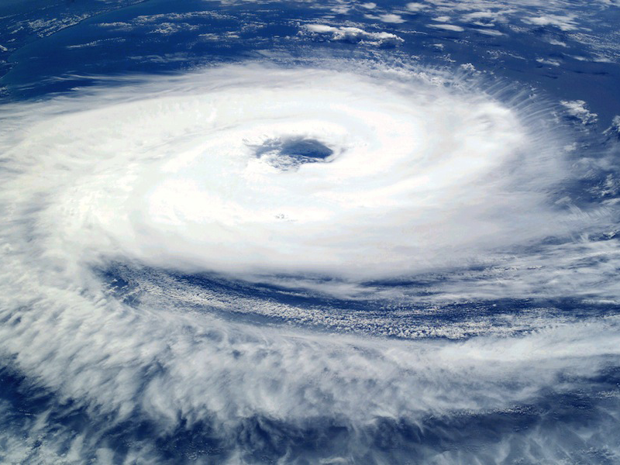
Have you ever experienced the power of a tropical cyclone?

Slide 7
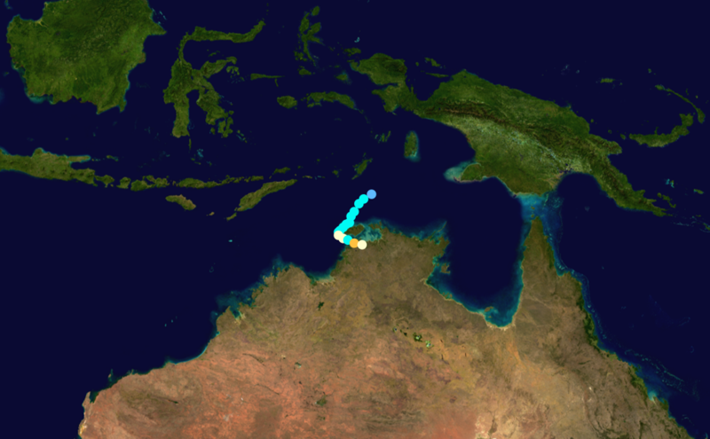

Cyclone Tracy
5
Christmas 1974
4
240 km/hr wind gusts
3
80% of Darwin flattened
2
41 000 out of 47 000 homeless
1
damage bill $837 million
Tropical storm
Tropical depression
Darwin

Slide 8
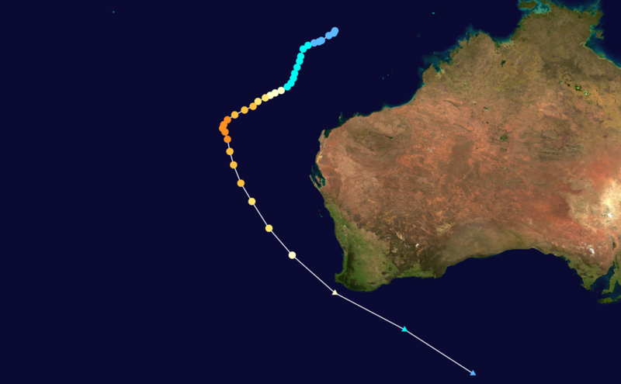
Cyclone Alby
5
April 1978
4
130 km/hr wind in Perth
3
erosion by storm surge
2
114 000 ha of land burned
1
damage bill $39 million
Tropical storm
Tropical depression
Perth

Slide 9
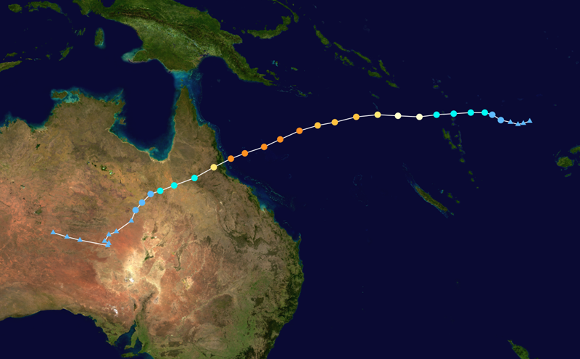
Cyclone Yasi
5
February 2011
4
285 km/hr winds
3
thousands evacuated
2
major crop devastation
1
damage bill $800 million
Tropical storm
Townsville
Tropical depression

Slide 10
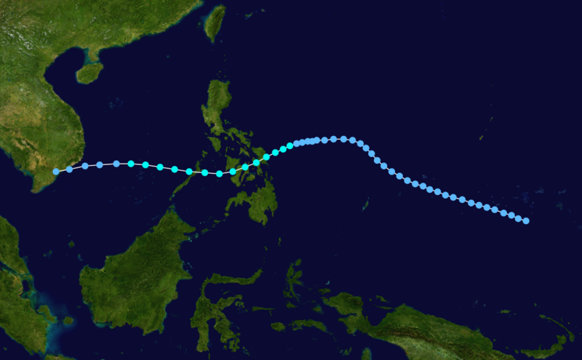
Tropical storm Thelma
5
November 1991
4
80 km/hr winds
3
torrential rain (up to 580 mm)
2
The Philippines
dam failures, landslides
1
over 7000 casualties
Tropical storm
Tropical depression

Slide 11
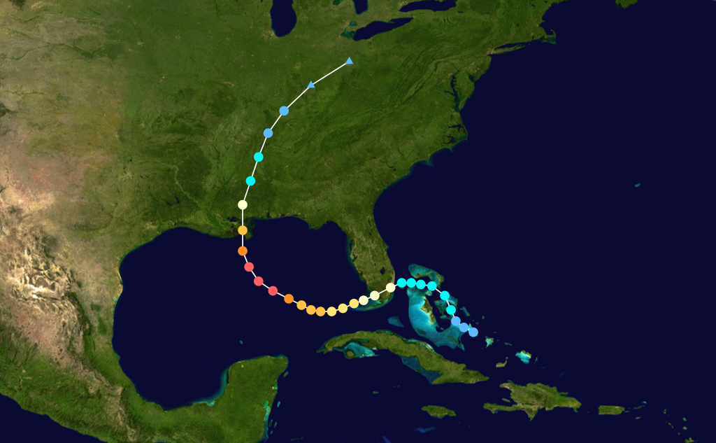
Hurricane Katrina
5
August 2005
4
205 km/hr winds
3
storm surge, levees failed
2
80% of city flooded
1
damage bill US$81 billion
Tropical storm
New Orleans
Tropical depression

Slide 12
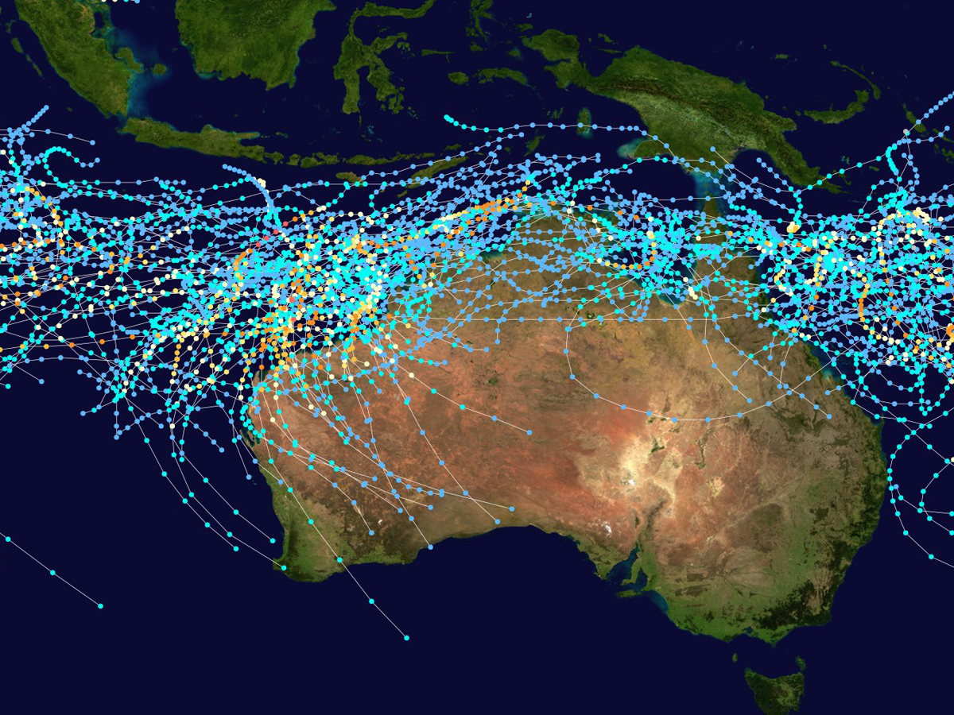
Australian region cyclone tracks (1985–2005)

Slide 13
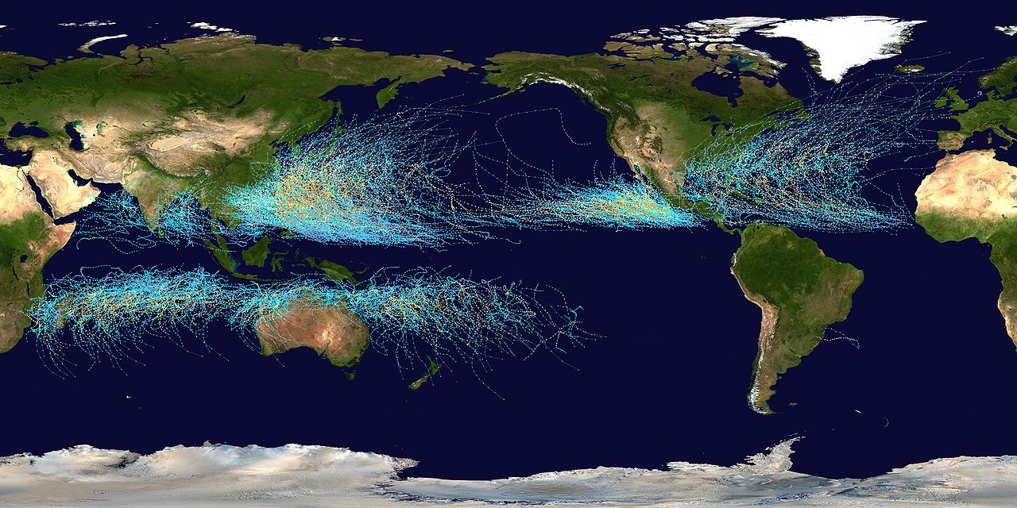
What do 20 years of global cyclone tracks show?
(1985–2005)

Slide 14
Success criteria
Use data to analyse historical patterns of cyclones
List and describe global features associated with frequent cyclones, eg latitudes, continental or oceanic features
List features of cyclones that create damage to life or property
Name 3 countries or continents that get a lot of cyclones

Slide 15
© 2012, The University of Western Australia
ast0932 | version 1.1 revised February 2013
For conditions of use see spice.wa.edu.au/usage
Developed for the Department of Education, Western Australia

